Slide 1
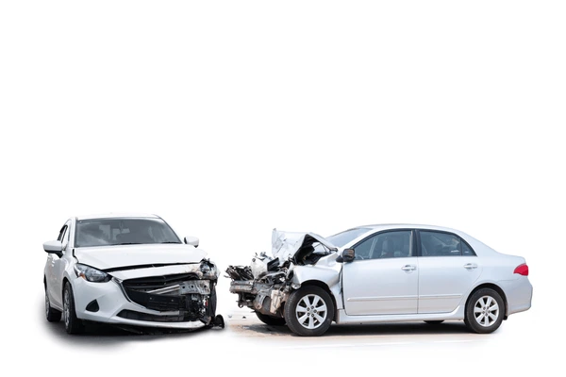
ENHANCING VEHICLE SAFETY: A COMPREHENSIVE APPROACH TO DROWSINESS MONITORING AND DAMAGE DETECTION
Project submitted by
JOBIN SHERY MATHEW
under the supervision of
Dr. M. Rajeswari, ASSOCIATE PROFESSOR

Slide 2
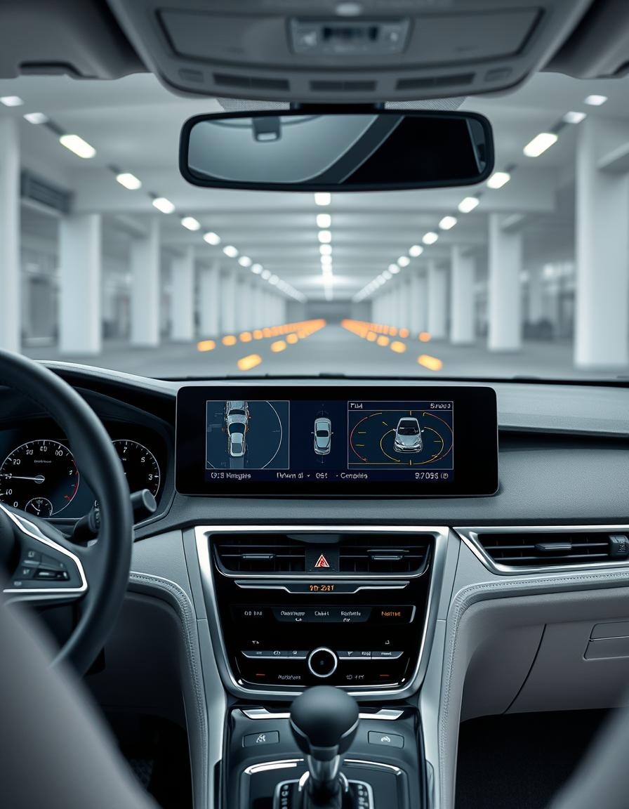
INTRODUCTION
The goal is to improve road safety by continuously tracking the driver’s alertness and assessing vehicle damage if an incident occurs, all integrated through a Streamlit-based application.
Aspect | Traditional Method | Proposed Model
Claim Processing | Manual inspection, labour-intensive | Automated processing using CNNs
Processing Time | Time-consuming | Significant reduction in processing time
Inspection Type | Visual and physical inspections | Image-based assessment using CNNs
Efficiency | Potentially low due to manual processes | Improved efficiency with automated processing
Accuracy | Prone to human error | Higher accuracy with CNNs
Customer Experience | Delays in processing, potential dissatisfaction | Faster processing, improved satisfaction.

Slide 3
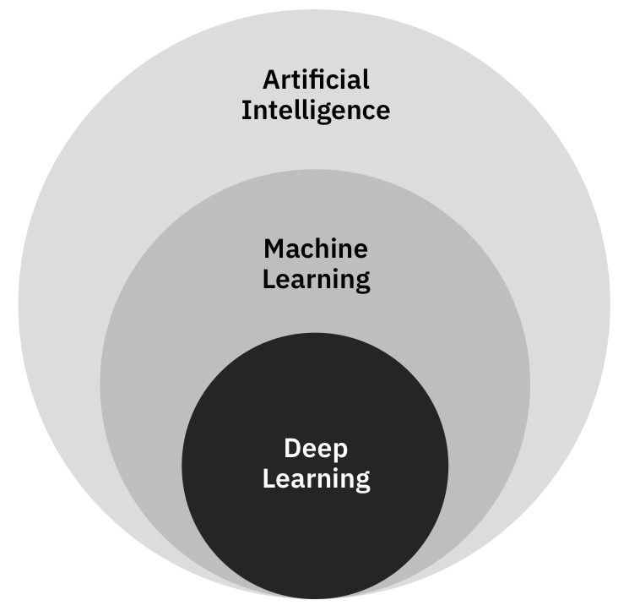
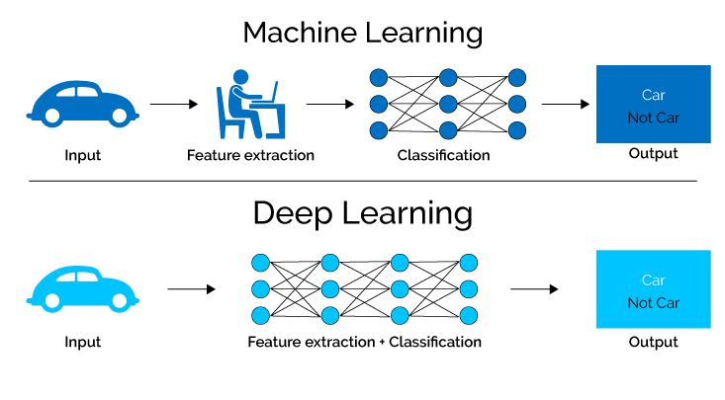
DOMAIN - DEEP LEARNING
What is it? - Deep learning is a subset of machine learning that utilizes artificial neural networks to model and understand complex patterns in large amounts of data. It is particularly effective for tasks involving unstructured data like images, audio, and text. In the context of car damage detection, deep learning algorithms, such as Convolutional Neural Networks (CNNs), are used to automatically learn and extract relevant features from images of vehicles, enabling the identification and classification of damaged areas.
Role of Deep Learning in Car Damage Detection
Deep learning, particularly CNNs, automates vehicle damage identification by extracting features from images. It excels at discerning subtle damage patterns and generalizes well to new, unseen data. Transfer learning further enhances efficiency by adapting pre-trained models for specific tasks, reducing the need for extensive training.

Slide 4
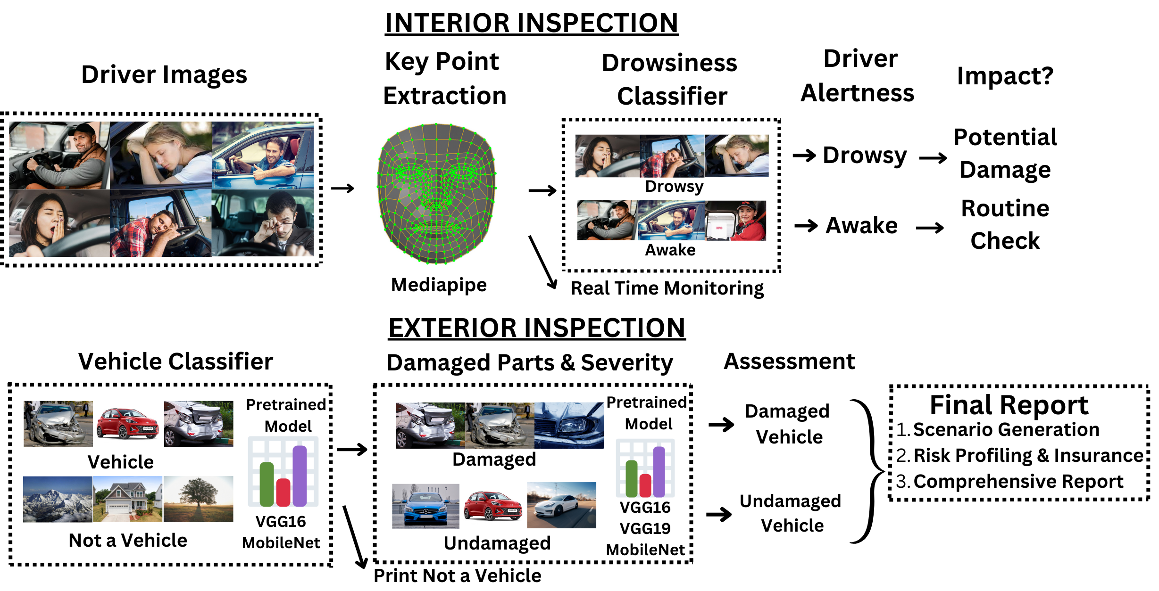
Architecture Diagram
MediaPipe is an open-source framework developed by Google for building multimodal (e.g., audio, video, sensor)
Performance and Efficiency
Accuracy compared to other
Cross-Platform

Slide 5
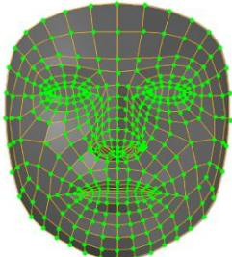
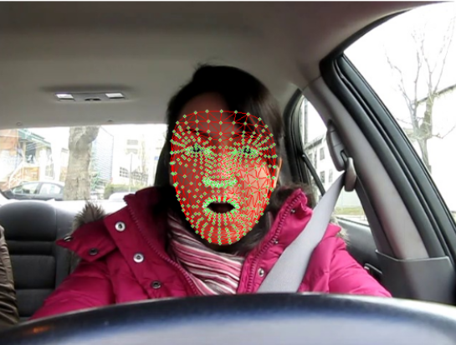
DROWSINESS DETECTION
MODEL SELECTION -MediaPipe combines real-time efficiency, high accuracy, and ease of integration, making it an ideal choice for in-vehicle drowsiness detection compared to other available models and frameworks. Robust Facial Landmark Detection (468 keypoints) , Lightweight Yet Powerful
MODEL CONFIGURATION - MediaPipe's face mesh model analyzes key facial features, particularly around the eyes and mouth, to detect signs of drowsiness such as eye closure and yawning
REAL-TIME PROCESSING -MediaPipe offers fast and efficient real-time facial landmark tracking, making it suitable for in-car applications where timely detection is crucial.
With Mesh

Slide 6
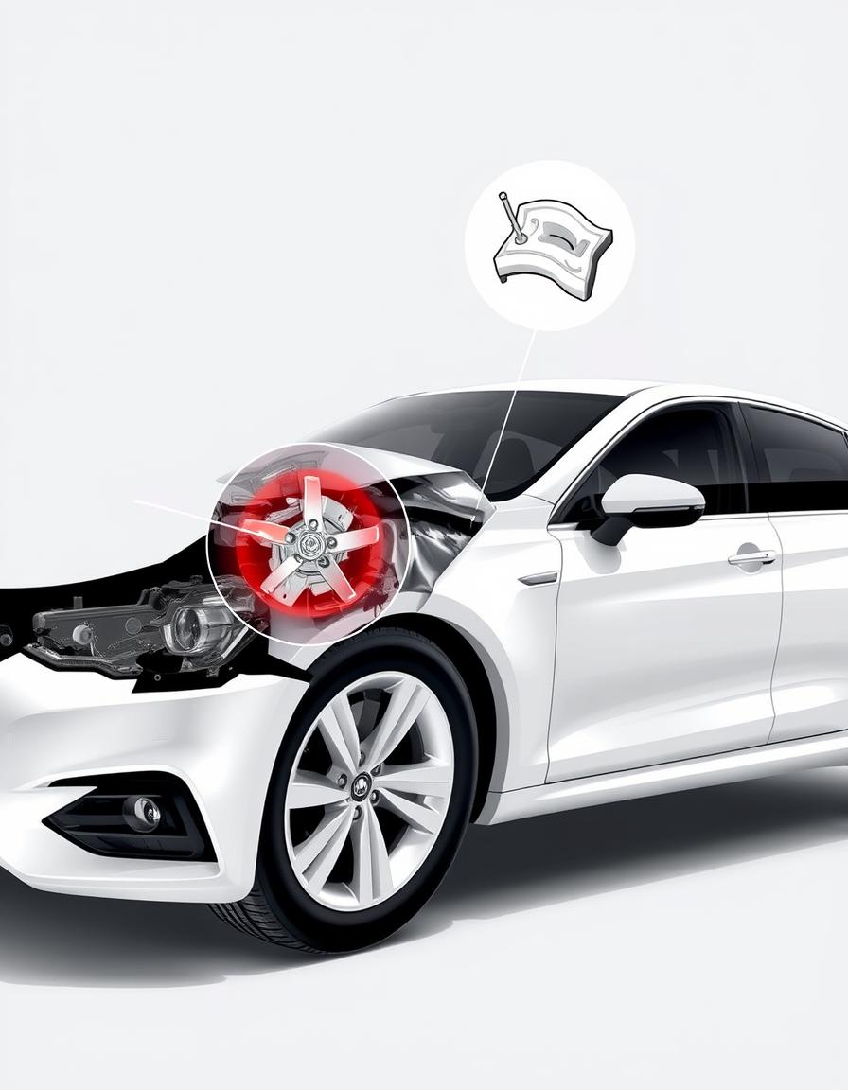
CAR DAMAGE DETECTION
MODEL SELECTION -Selecting the right pre-trained CNN model, such as VGG16, VGG19, DenseNet121, or MobileNet, is crucial. These models are effective for image classification and have been trained on large datasets like ImageNet.
MODEL CONFIGURATION - Configure the selected model for car damage detection by removing its top layers and adding new layers suitable for the task. This process, known as transfer learning, uses the pre-trained model as a feature extractor.
TRANSFER LEARNING -Leverage transfer learning to apply knowledge learned from a large dataset to a new, related task with a smaller dataset.
DATA AUGMENTATION -Augment the training dataset by creating modified versions of existing images. This helps improve the model's generalization and robustness.

Slide 7
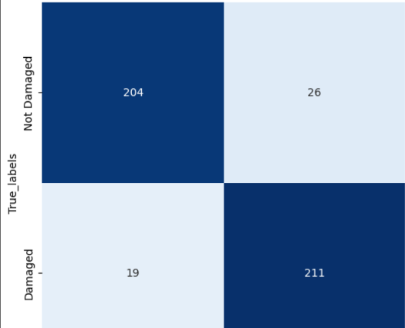
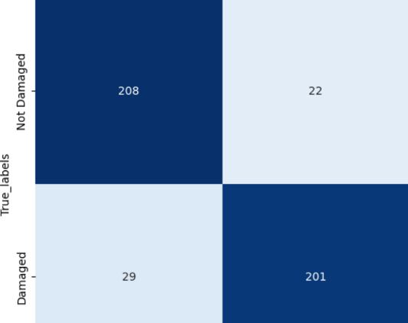
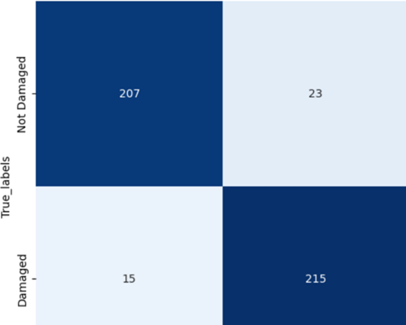
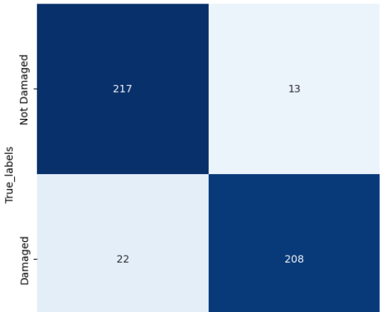
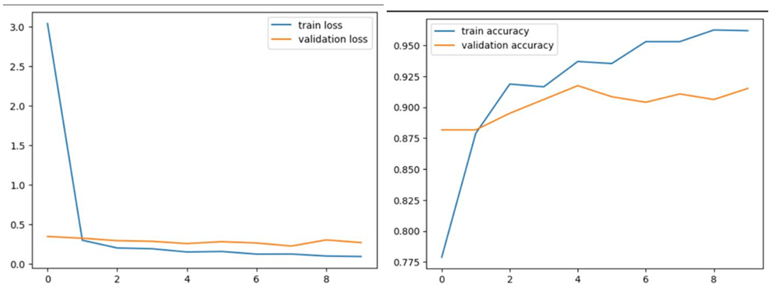
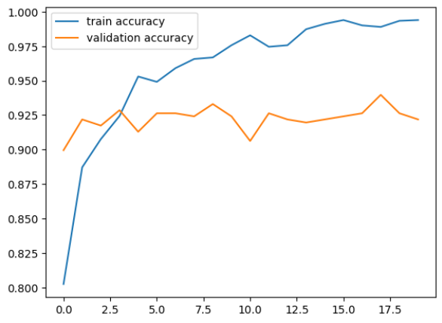
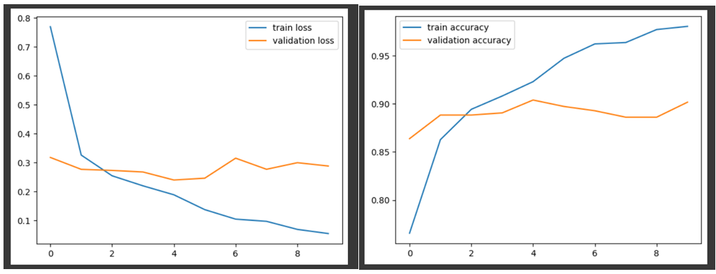
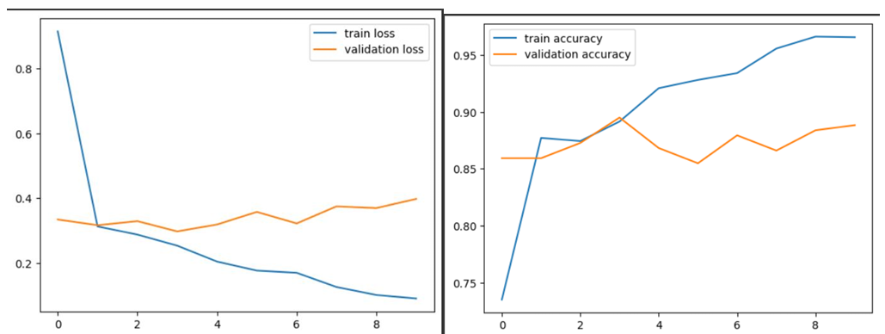
Results for training loss
FOR VGG16 FOR VGG19 FOR DENSENET FOR MOBILENET
Results for training accuracy

Slide 8
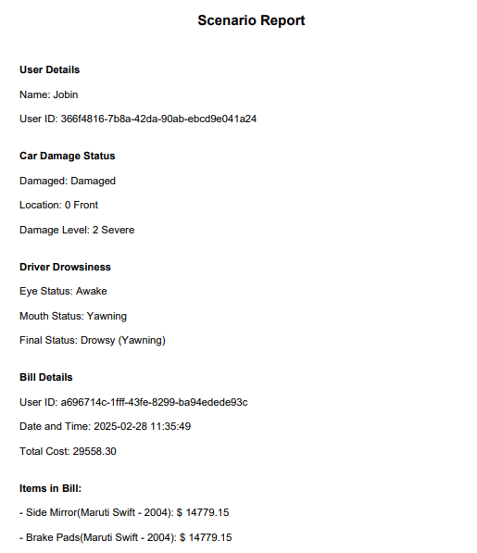
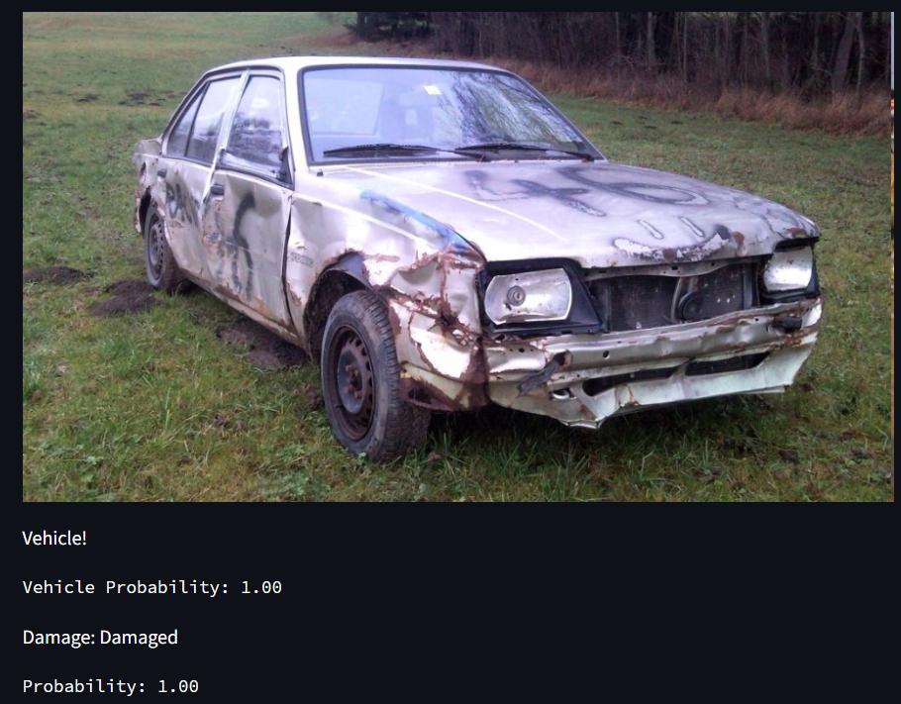
Results
Results for Damaged
Pretrained Model | Precision | Recall | F1 Score | Accuracy | Loss
VGG16 | 0.89 | 0.92 | 0.90 | 90.21 | 0.020
VGG19 | 0.90 | 0.87 | 0.89 | 88.91 | 0.039
DenseNet121 | 0.90 | 0.93 | 0.92 | 91.73 | 0.053
MobileNet | 0.94 | 0.89 | 0.91 | 91.73 | 0.004

Slide 9
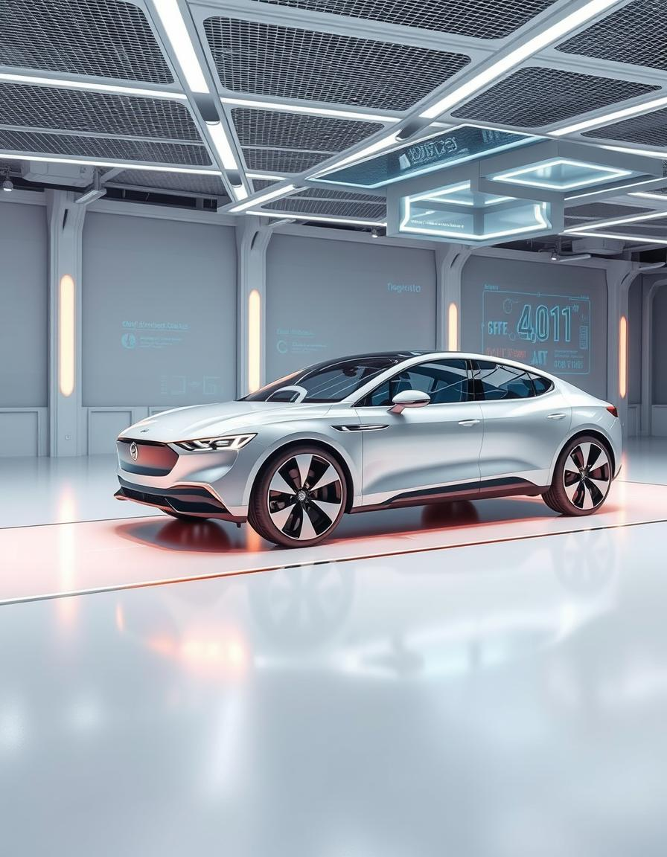

Conclusion and Future Enhancement
This AI-driven system effectively detects driver drowsiness and vehicle damage, enhancing road safety and improving insurance claim processes. The Streamlit interface offers user-friendly access to real-time monitoring and repair cost estimation.
Future enhancements could include IoT-based vehicle monitoring, passenger health evaluation via wearables, and AI assessment of injuries and damages, further advancing accident prevention and emergency response.

Slide 10
REFERENCES
Kyu, P.M., Woraratpanya, K. Car Damage Detection and Classification. Engineering Applications of Artificial Intelligence, 2023.
Dwivedi, M., Hashmat, M., et al. Deep Learning Based Car Damage Classification and Detection, 2019.
Martis, J.E., et al. Car Damage Assessment Recommendation System Using Neural Networks. Materials Today: Proceedings, 2023.
Wassel, M. Deterring Claims Leakage in the Digital Age. Cognizant Insurance Practice, 2018.
Supraja, K., Saritha, S.J. Robust Fuzzy Rule Based Technique to Detect Frauds in Vehicle Insurance. IEEE ICECDS’17, 2017.
Deng, J., Dong, W., et al. ImageNet: A Large-Scale Hierarchical Image Database. IEEE CVPR, 2009.
Tammina, S. Transfer Learning Using VGG-16 for Classifying Images.
Medium - Car Damage Classification Using Deep Learning.
M, S.C., Kunjumon, S., R, N. Car Damage Identification and Categorization Using Transfer Learning Models. IEEE ICOEI, 2021.
Redmon, J., Divvala, S., Girshick, R., Farhadi, A. You Only Look Once: Unified, Real-Time Object Detection. IEEE CVPR, 2016.
Shorten, C., Khoshgoftaar, T.M. A Survey on Image Data Augmentation for Deep Learning. Journal of Big Data, 2019.
Wang, X., Li, W., Wu, Z. CarDD: A New Dataset for Vision-Based Car Damage Detection. IEEE Transactions on Intelligent Transportation Systems, 2023.
Maiano, L., Montuschi, A., et al. A Deep-Learning-Based Antifraud System for Car-Insurance Claims.
Dhieb, N., Ghazzai, H., Besbes, H., Massoud, Y. A Very Deep Transfer Learning Model for Vehicle Damage Detection and Localization, 2019.

